Slide 1
Identifying Covid-19 patients from Chest X-Rays
Kester chia

Slide 2
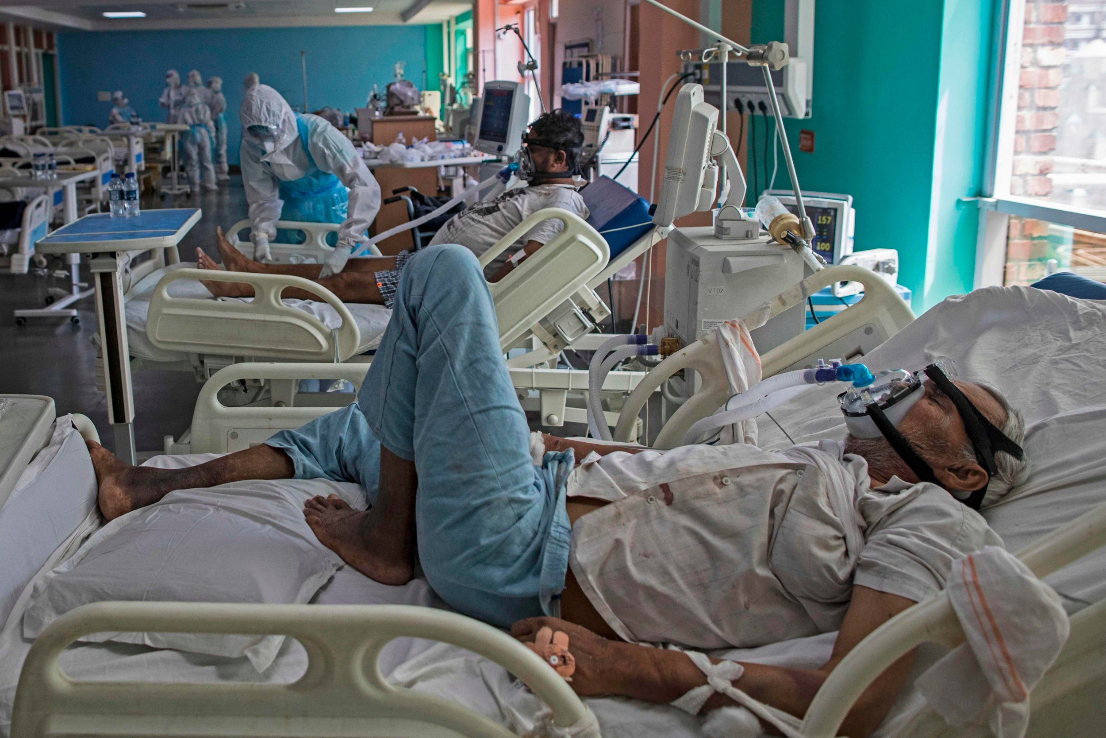
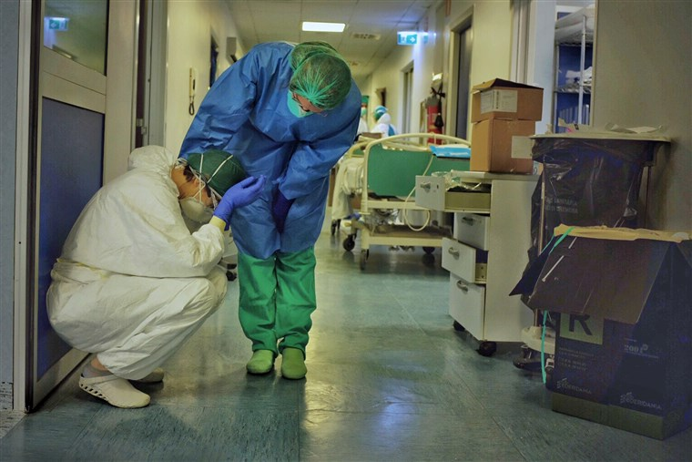
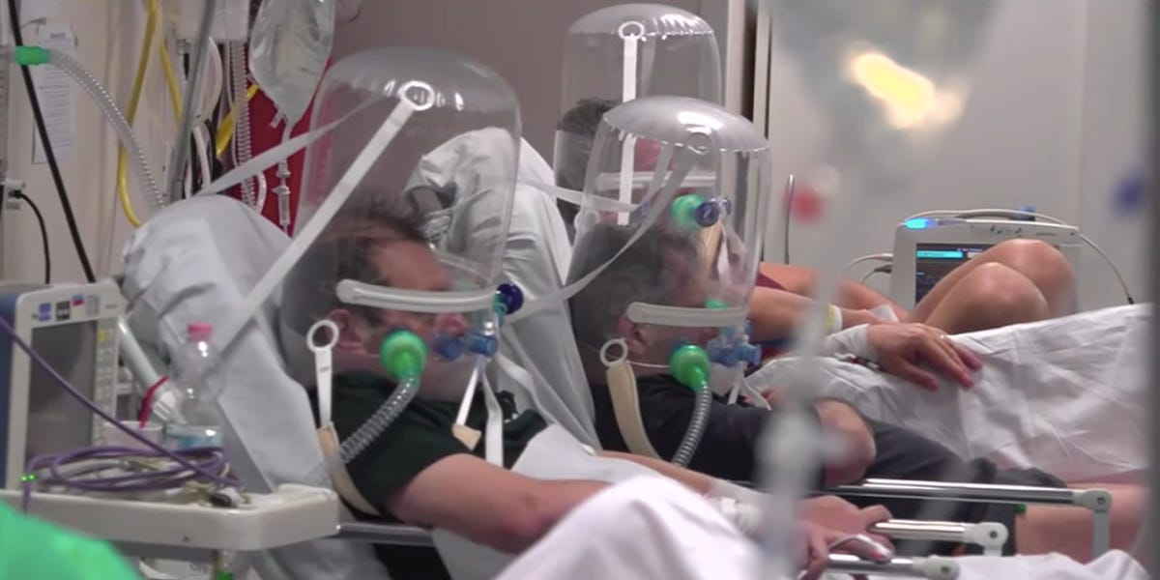
Overwhelmed Hospitals
Notes:
Sources:
https://www.nbcnews.com/health/health-news/italy-has-world-class-health-system-coronavirus-has-pushed-it-n1162786
https://www.independent.co.uk/news/world/asia/india-coronavirus-cases-deaths-million-covid-latest-a9623821.html

Slide 3
Building a model to detect infections from Chest X-Rays
Detect
Detect presence of infection, as well as type (Viral/Bacterial)
Streamline
Streamline case detection and save hospital resources
Relieve
Relieve burden on healthcare systems

Slide 4
Dataset
We will be using a dataset containing Chest X-Rays of patients.
The dataset was downloaded from Kaggle: https://www.kaggle.com/praveengovi/coronahack-chest-xraydataset
The dataset contains ~5800 jpeg images of Chest X-Rays of Healthy patients, as well as patients affected with Pneumonia. The pneumonia X-Rays contain cases of bacterial infections as well as viral infections, such as SARS (Severe Acute Respiratory Syndrome ) ,Streptococcus & ARDS (Acute Respiratory Distress Syndrome).

Slide 5
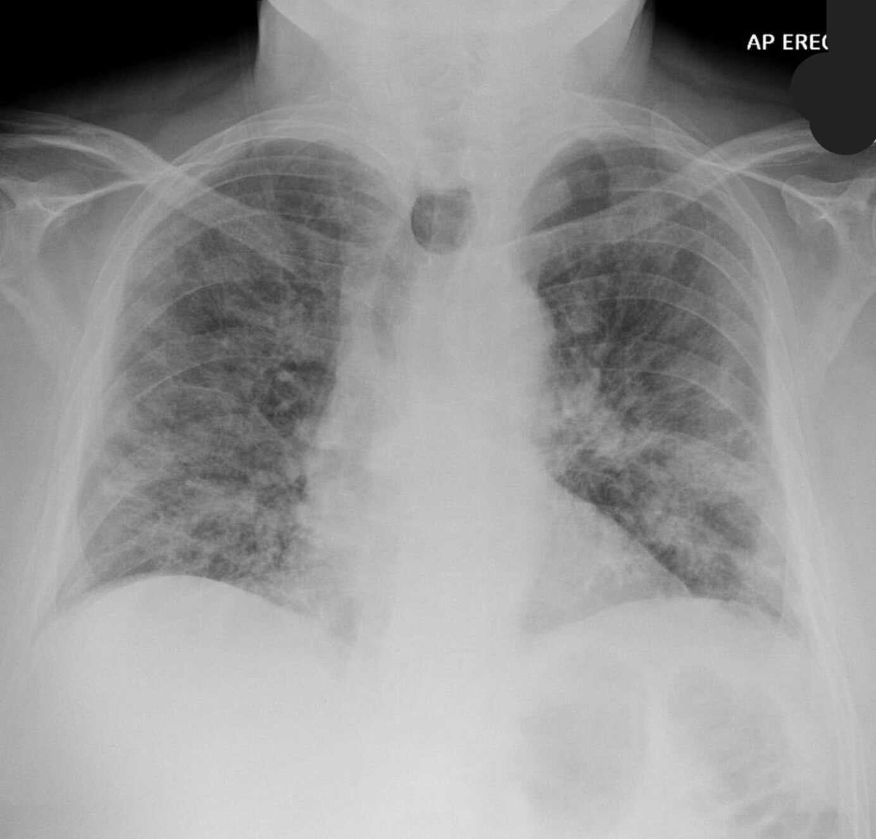
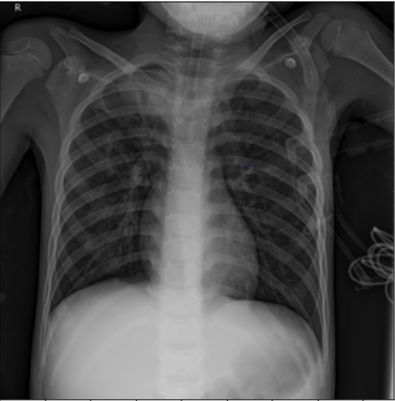
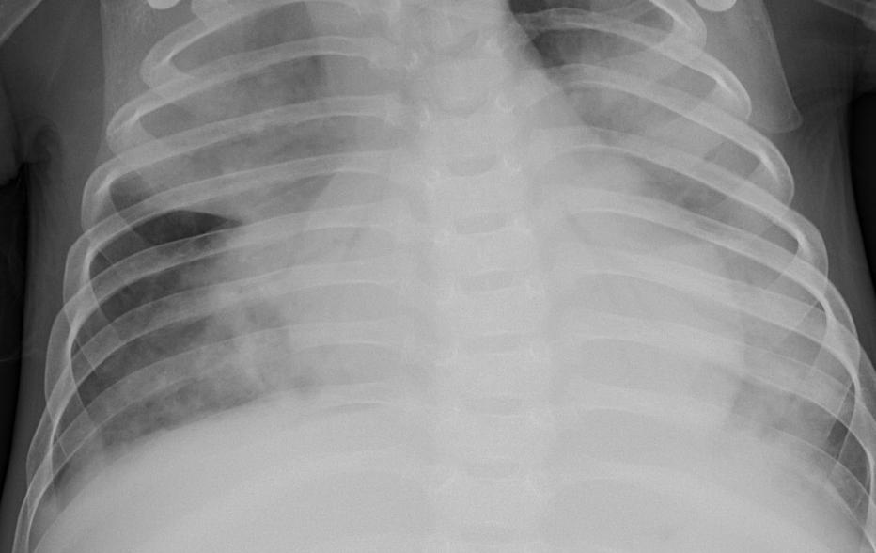
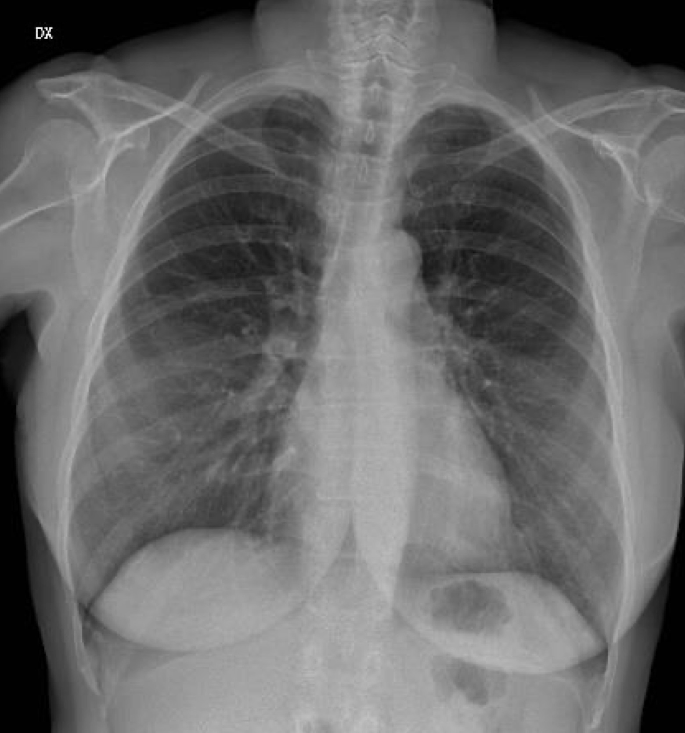
Chest X-Rays
Covid-19
Viral (Non-Covid)
Bacterial
Healthy
Notes:
Sources:
https://www.latimes.com/world-nation/story/2020-05-13/in-wuhan-new-coronavirus-infections-spark-mass-testing-renewed-restrictions-and-residents-worries

Slide 6
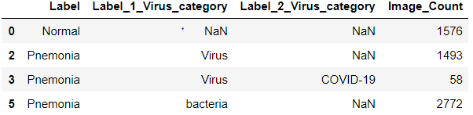
Dataset summary
The dataset is very imbalanced, with only 58 images for the Covid-19 class.
We address this issue by image augmentation and implementing class weights.

Slide 7
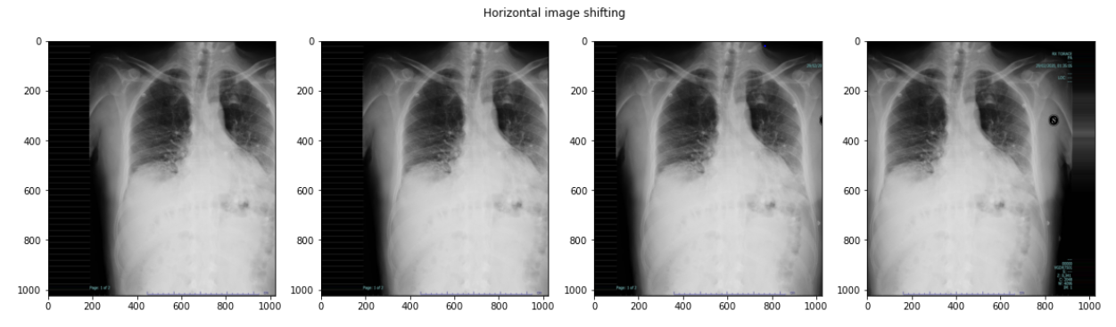
Image augmentation: Horizontal shifting

Slide 8
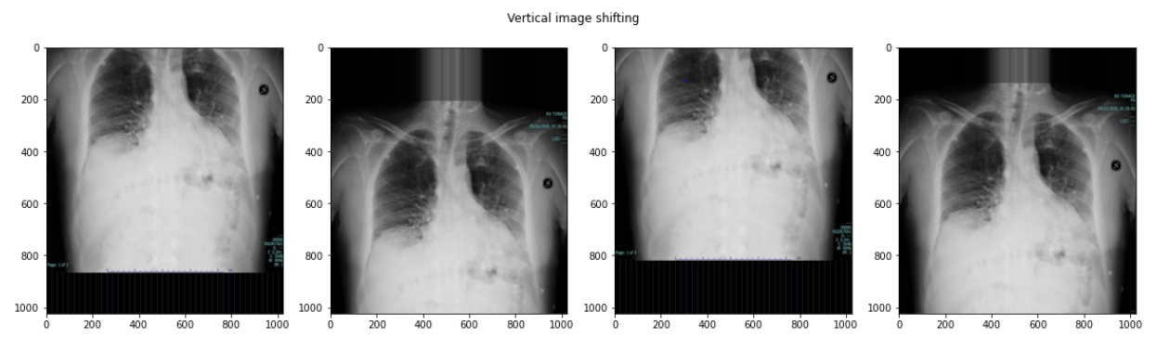
Image augmentation: Vertical Shifting

Slide 9
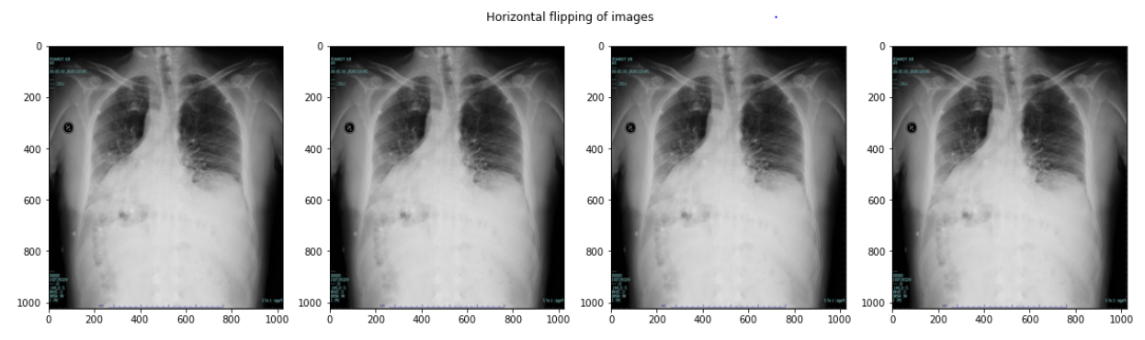
Image augmentation: Lateral inversion

Slide 10
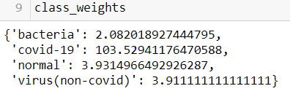
Class weights
Class weights are calculated as a simple inverse of (class count / total count).
Covid-19 classified X-Rays are given significantly higher weights in this approach.

Slide 11

Building a model

Slide 12
Model choice: Convolutional neural network
Commonly used for image classification problems
Well established CNN architectures available to use as a starting point, instead of starting from scratch (LeNet-5, AlexNet, VGG etc.)
Images are not sequential, therefore Recurrent Neural Networks (RNNs) are not relevant

Slide 13
Model parameters:
Optimizer:
Adam was used as the optimizer, which sets per-parameter learning rates based on gradient functions
Scheduler:
On top of the Adam adjustments, the base learning rate was set to a reciprocal decay as epochs increased
Class weights:
Assigned as previously mentioned

Slide 14
Keras tuner
The Keras Tuner library was also used for hyperparameter tuning
Hyperparameters tuned:
Convolution size
Number of filters
Base learning rate for Adam optimizer

Slide 15

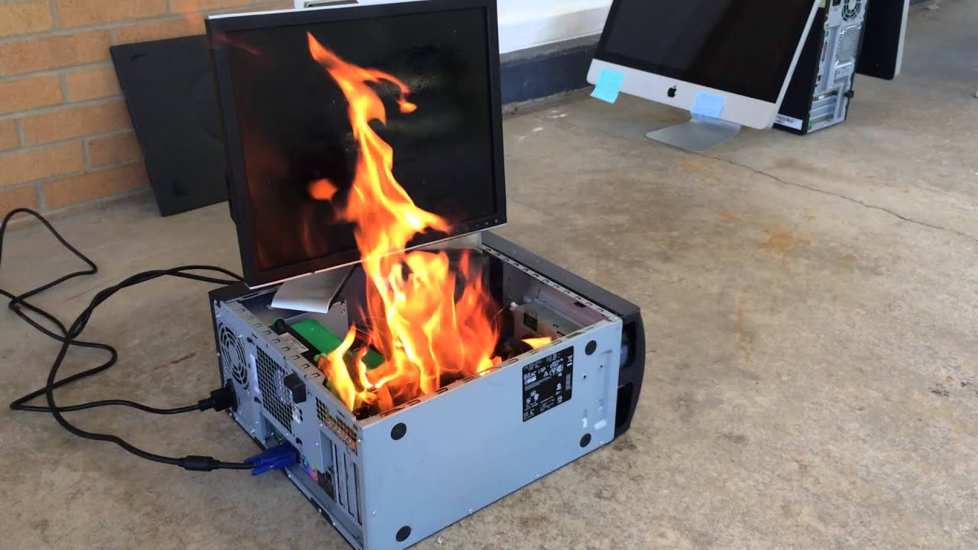

Tuning and Training the model:

Slide 16
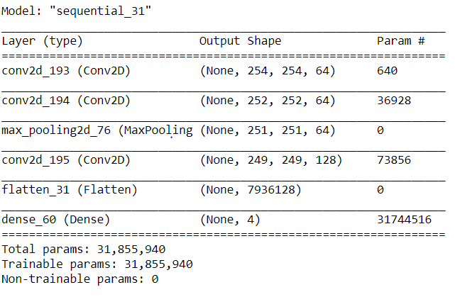
Final model architecture:
Deep architectures were attempted (VGG, AlexNet) but couldn’t seem to achieve higher accuracies.
After removing some layers, the final network is shallow with only 3 convolution layers and 1 pooling layer (Max pooling), with the final dense layer for the final classification output.

Slide 17
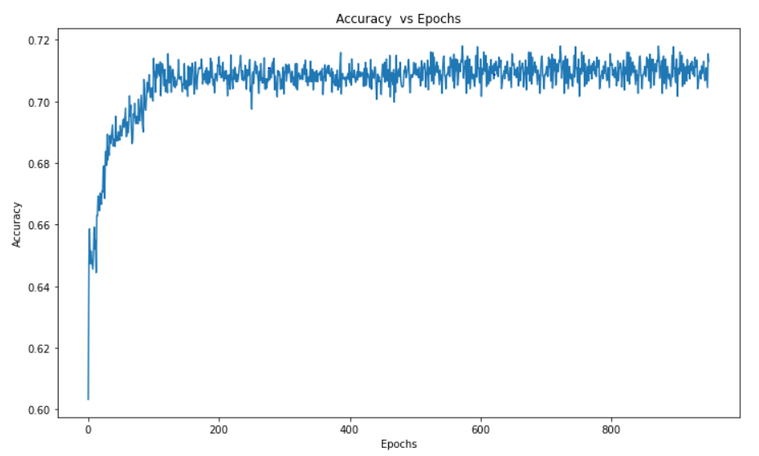
Evaluation
Model stagnates around 0.70-0.72 accuracy

Slide 18
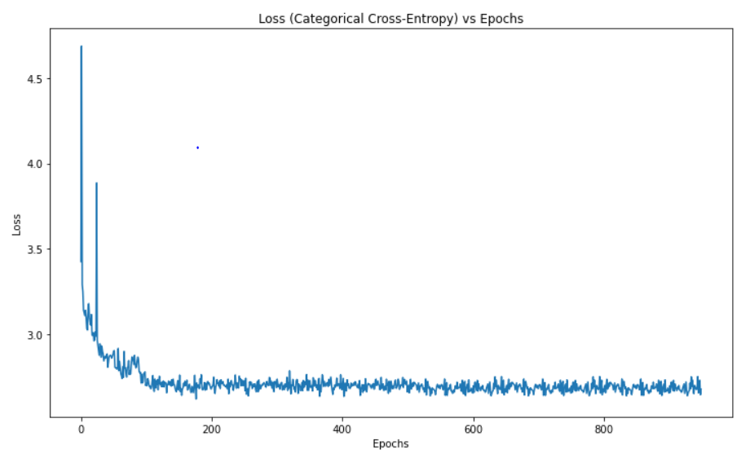
Evaluation
Similarly, loss function also converges after ~200 epochs

Slide 19
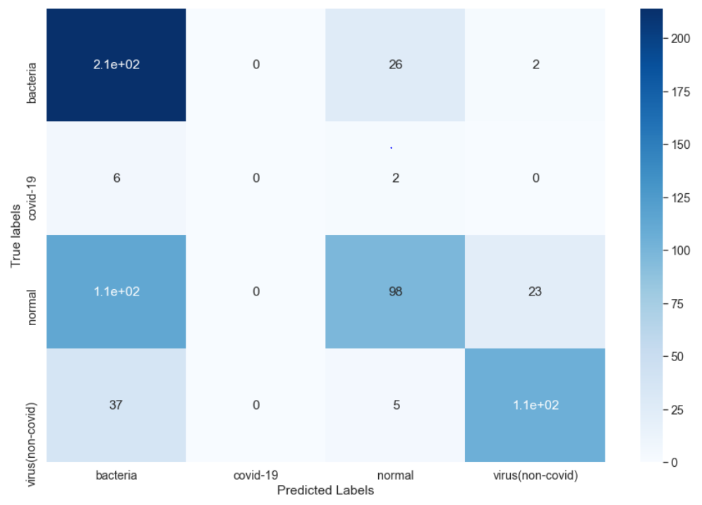
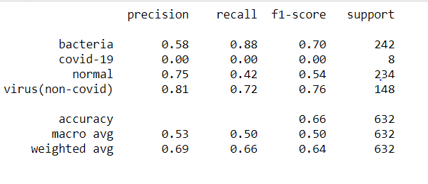
Evaluation
Model failed to pick up any of the covid-19 images
Predicts most images as bacterial infections

Slide 20
Evaluation

Slide 21
Weaknesses
Imbalanced dataset difficult to overcome
No data on the length of covid-19 infection; clouding (infected tissue) may be more visible on patients who have been infected for a longer period of time
Very difficult for model to differentiate between bacterial and viral infections

